Slide 1


Slide 2
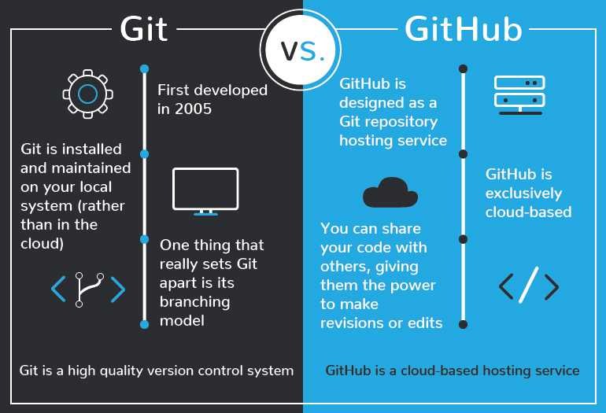

Slide 3
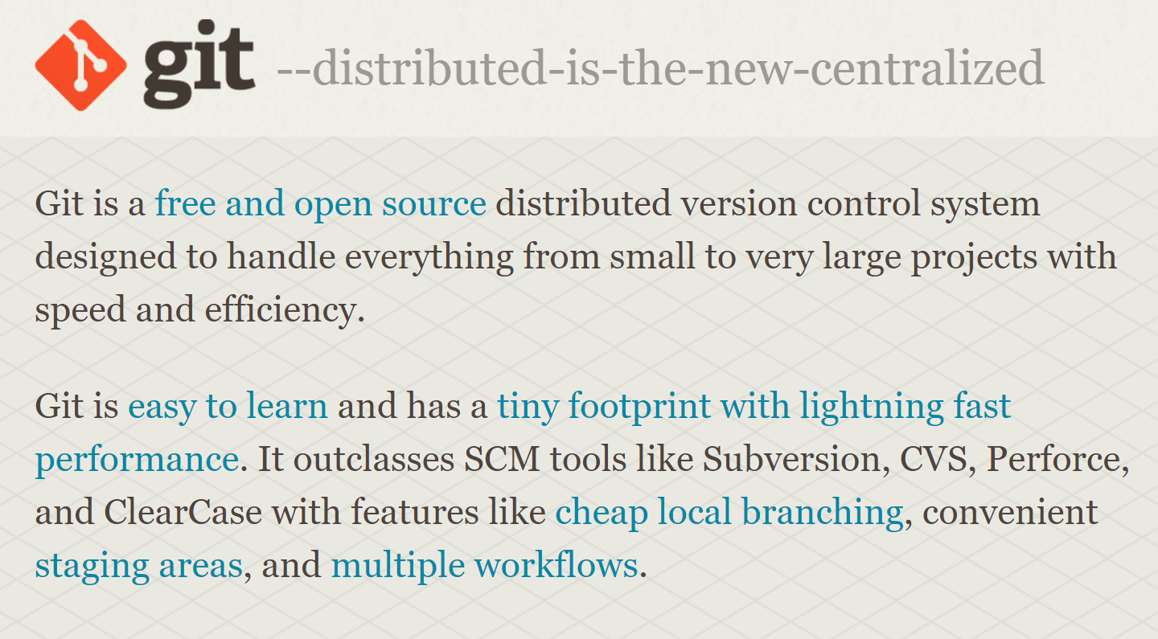

Slide 4
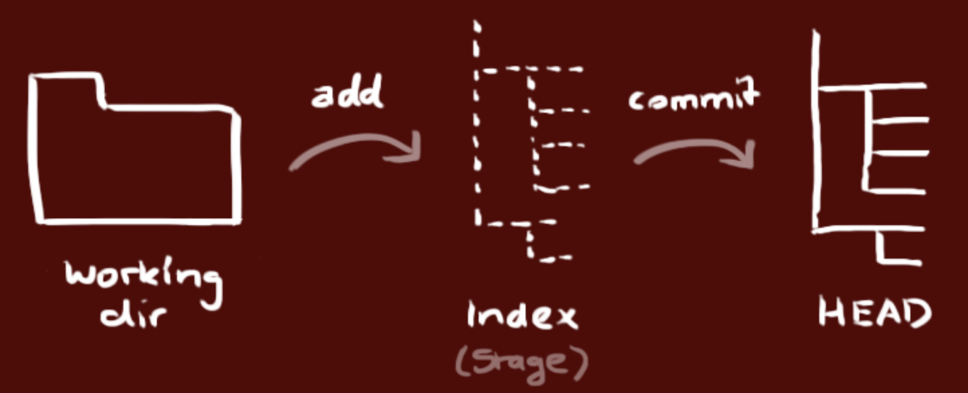
Your local repository consists of three "trees" maintained by git.
Notes:
your local repository consists of three "trees" maintained by git. the first one is your Working Directory which holds the actual files. the second one is the Index which acts as a staging area and finally the HEAD which points to the last commit you've made.

Slide 5
The first one is your Working Directory which holds the actual files
Notes:
your local repository consists of three "trees" maintained by git. the first one is your Working Directory which holds the actual files. the second one is the Index which acts as a staging area and finally the HEAD which points to the last commit you've made.

Slide 6
The second one is the Index which acts as a staging area
Notes:
your local repository consists of three "trees" maintained by git. the first one is your Working Directory which holds the actual files. the second one is the Index which acts as a staging area and finally the HEAD which points to the last commit you've made.

Slide 7
The HEAD which points to the last commit you've made.
Notes:
your local repository consists of three "trees" maintained by git. the first one is your Working Directory which holds the actual files. the second one is the Index which acts as a staging area and finally the HEAD which points to the last commit you've made.

Slide 8
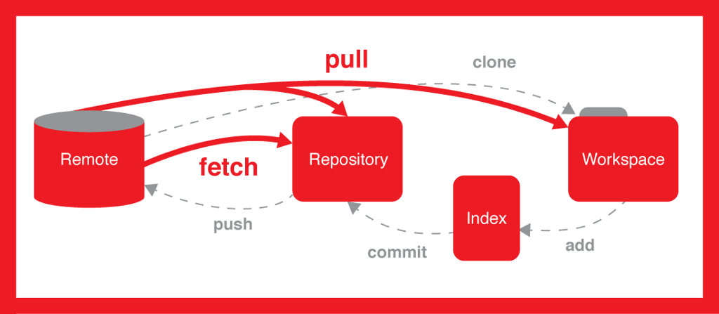

Slide 9
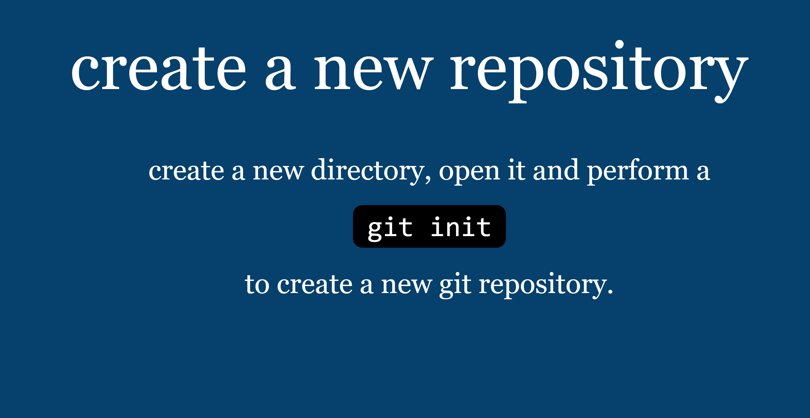

Slide 10
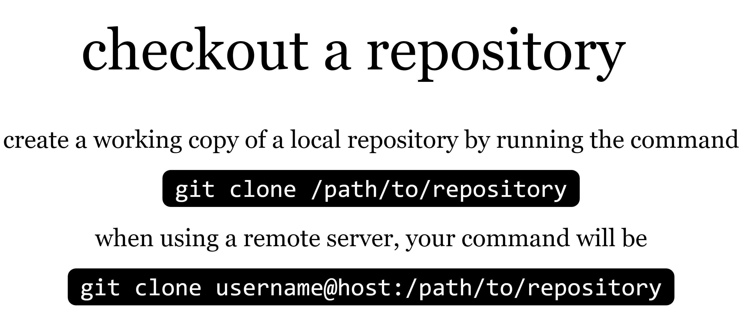

Slide 11
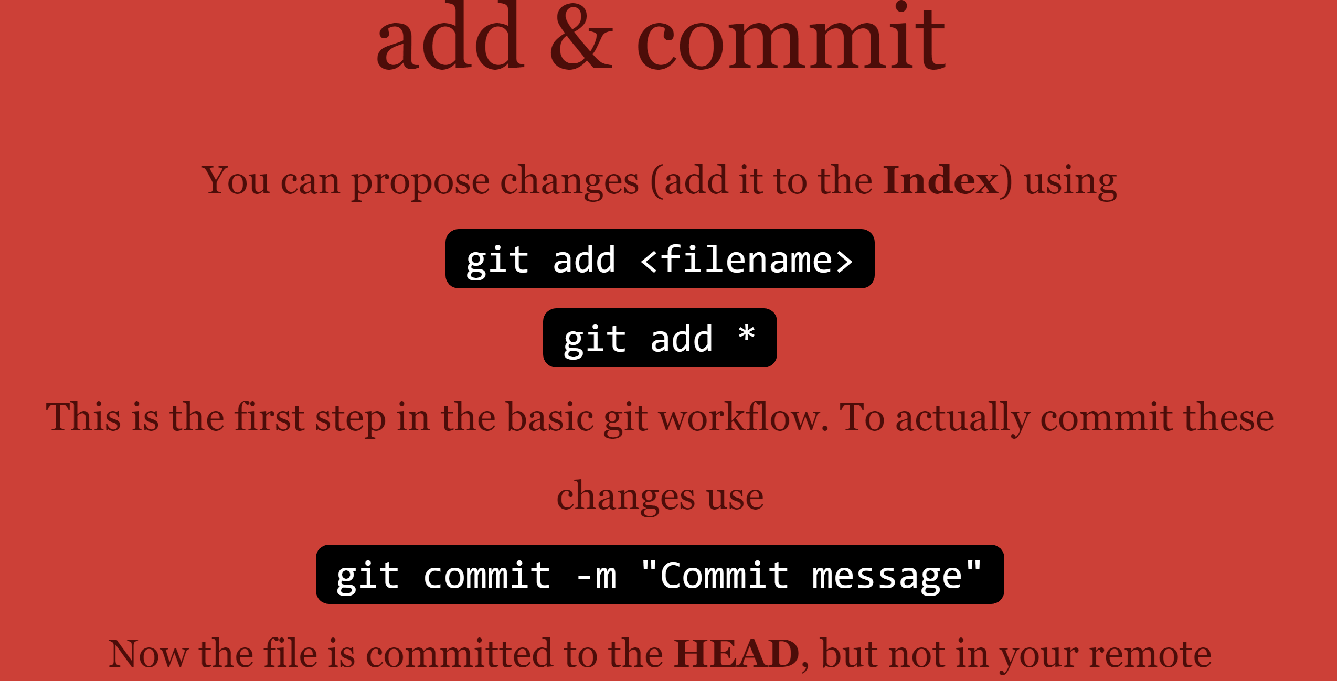

Slide 12
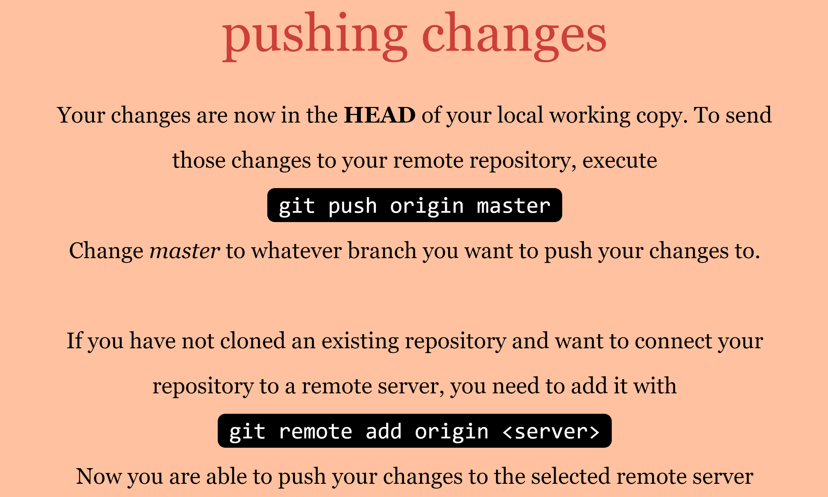

Slide 13
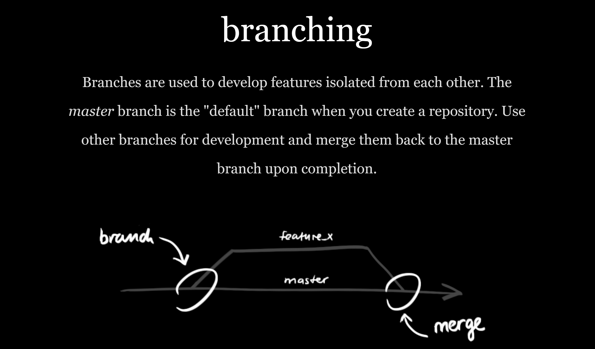

Slide 14
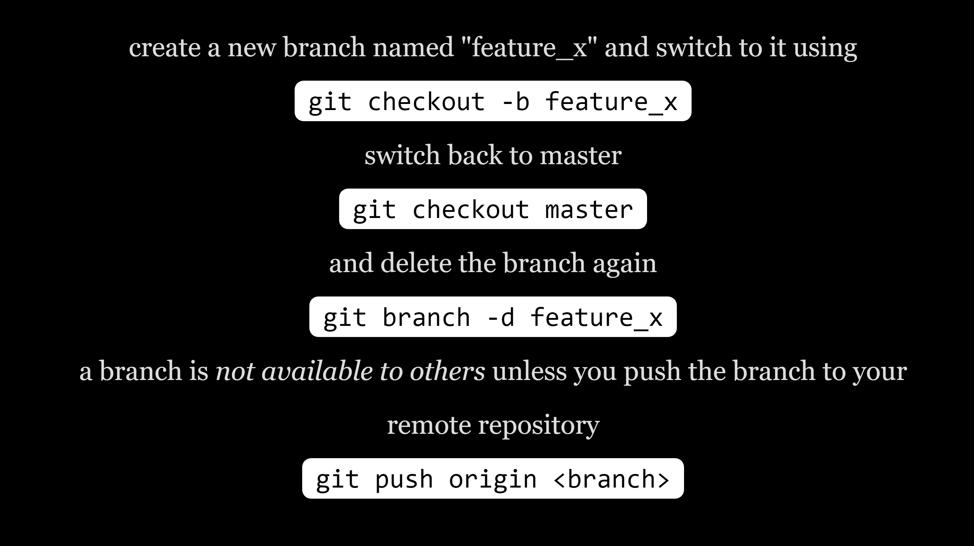

Slide 15
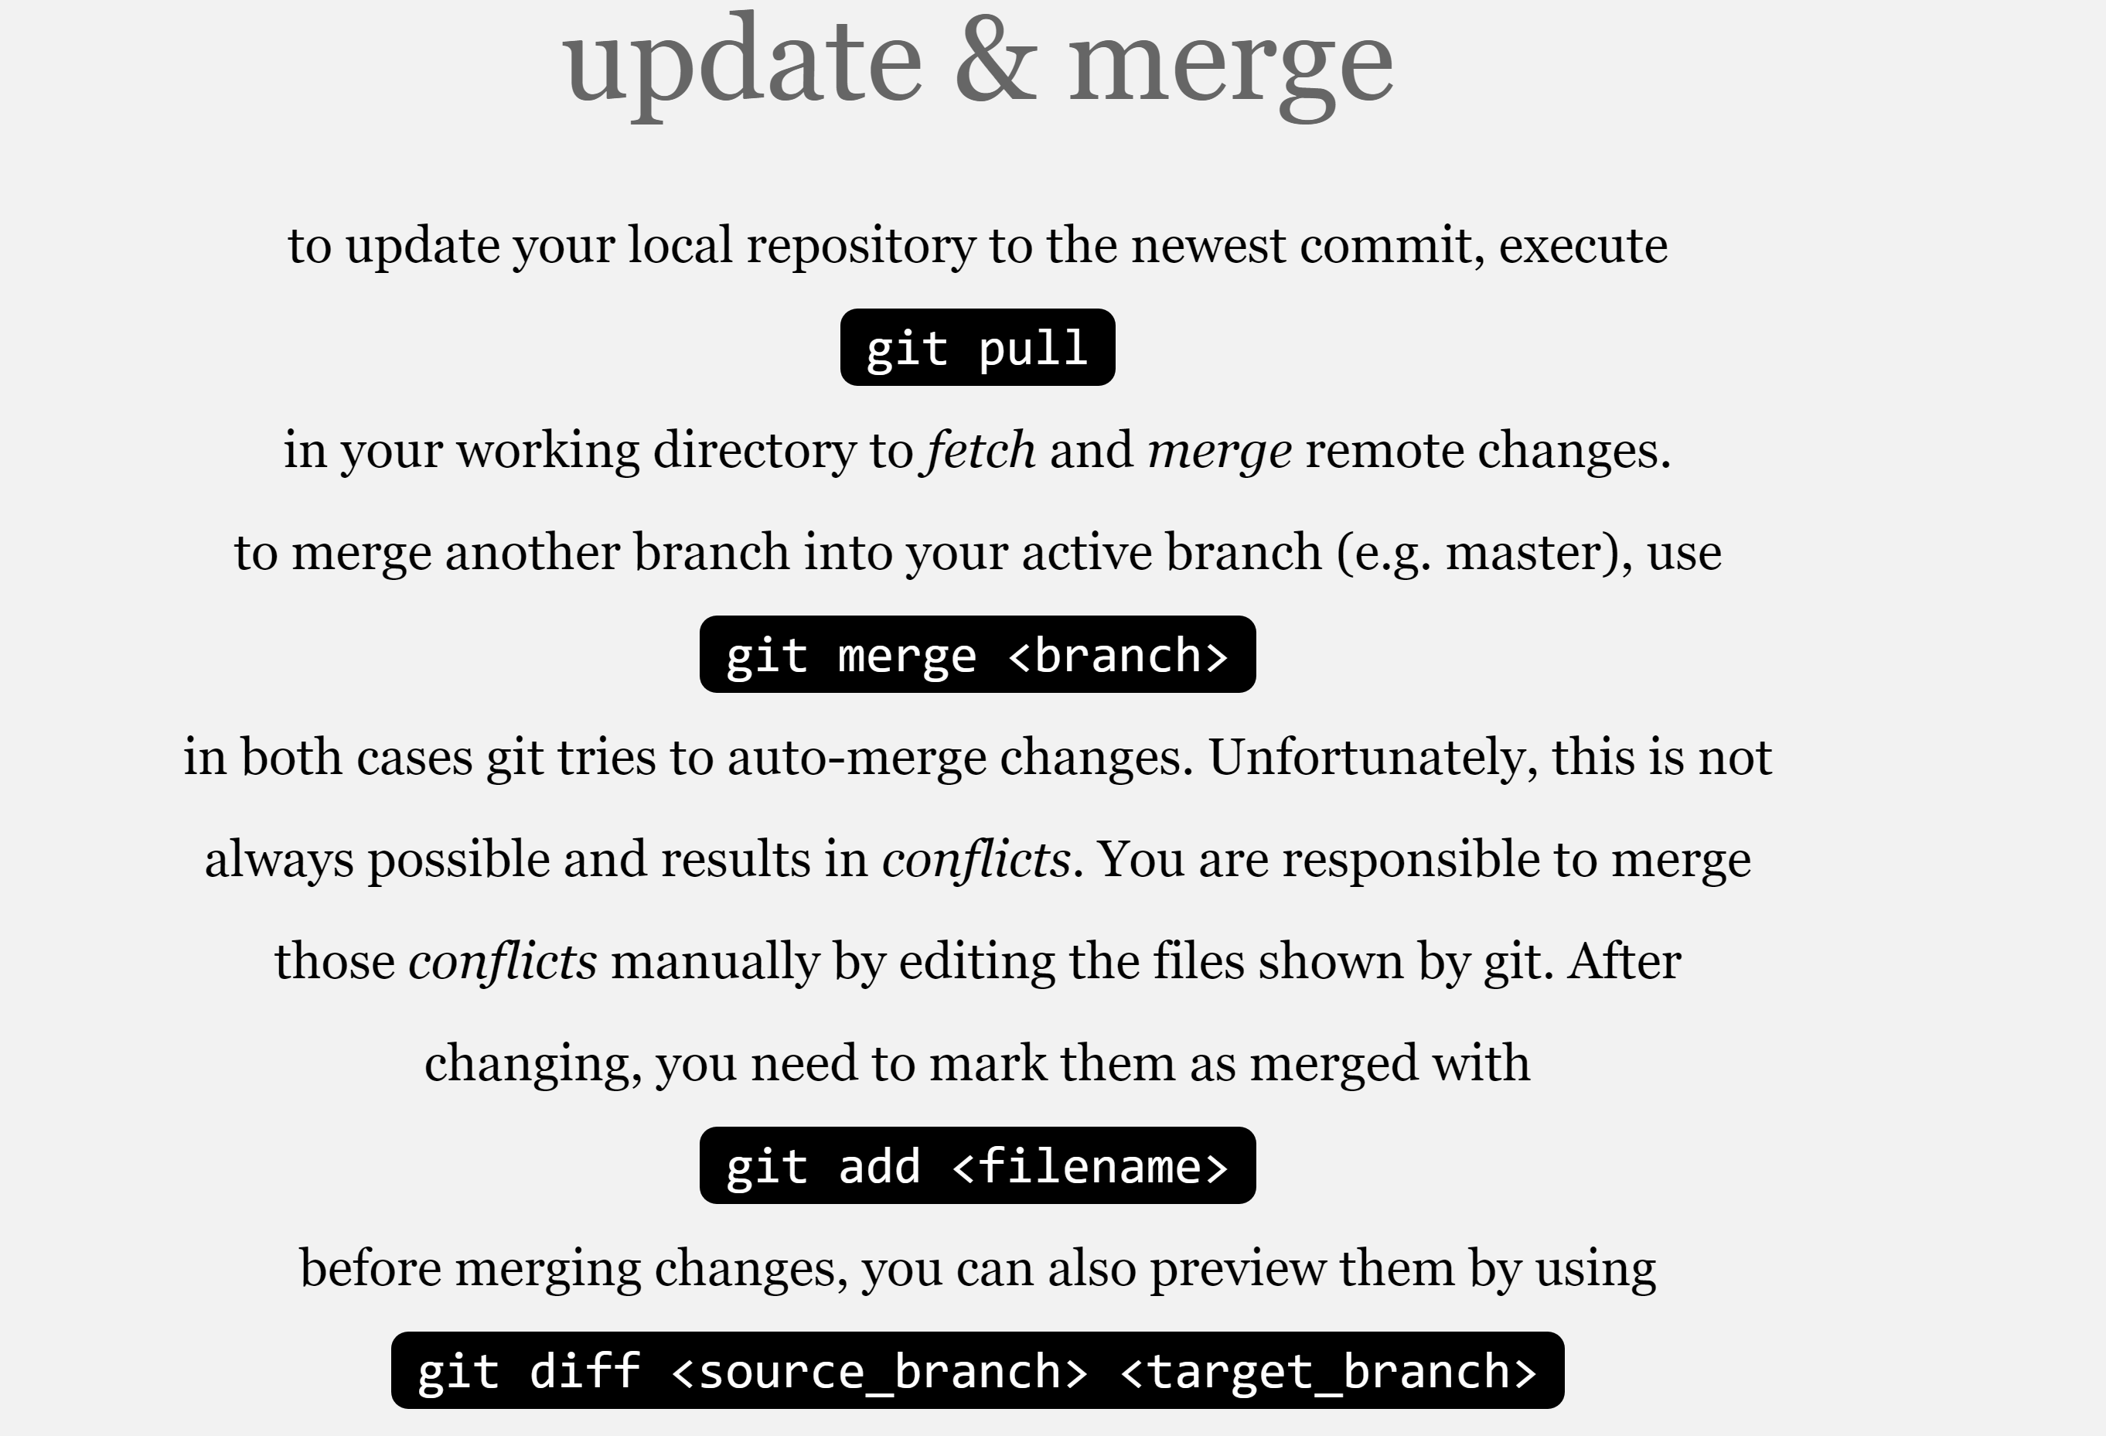

Slide 16
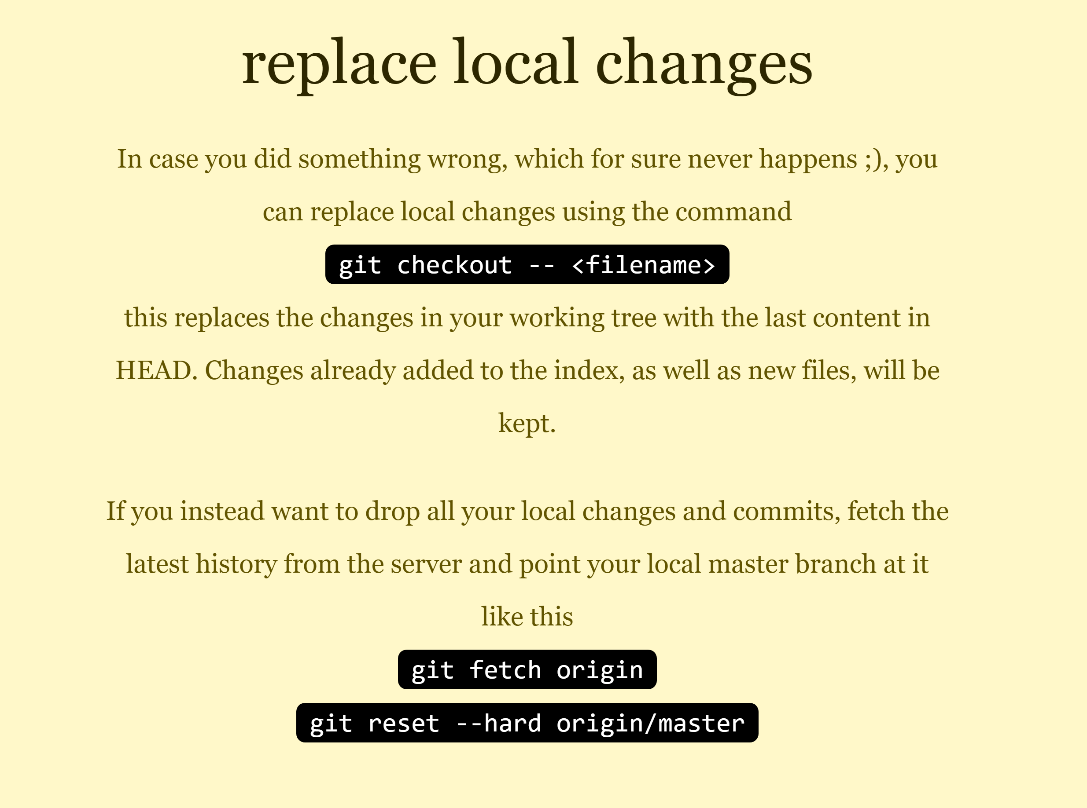

Slide 17

Notes:
https://www.gitkraken.com/

Slide 18
GIT Basic Guide
https://rogerdudler.github.io/git-guide/
GIT Detail/Book
https://git-scm.com/book/en/v2
GIT-SCM Download
https://git-scm.com/

